Slide 1
AMITY UNIVERSITY NOIDA B-TECH (it), Semester 3 Mr. purushottam sharma

Slide 2
Machine Learning in Face Recognition
By Anantya Thapliyal
A2305319128
B-Tech IT

Slide 3
objective
To study how face recognition technology works and what are the different types of methods used for facial recognition.
Applications of facial recognition is also discussed in this term paper, along with some limitations, and some methods to overcome them.

Slide 4
machine learning
Programming of a computer so that Machine can learn itself from data in order to make predictions or decisions without being explicitly programmed to do so is called machine learning. Machine learning techniques are used to automatically identify the pattern and extract the valuable underlying information from complex data.
Today Machine Learning has become one of the most dominating and powerful technologies. Machine Learning is making our life easier by refining our web results, creating new drugs, detecting online frauds, detecting cancer, recommending videos, self-driving cars, beating world champions in games like Alpha Go and chess and is constantly improving.

Slide 5
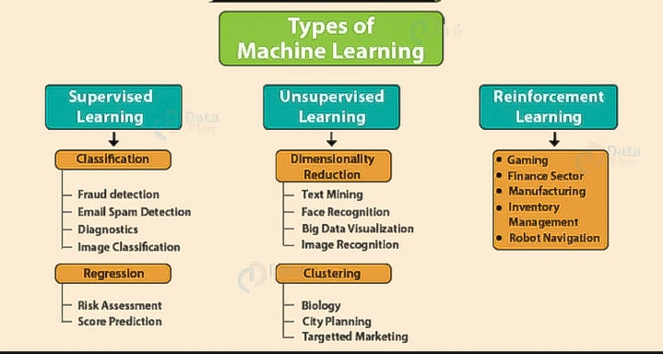
Types of machine learning
There are many ways in which the machine learns and understands a human pattern but generally, there are three main categories:
supervised learning
unsupervised learning
Reinforcement learning.

Slide 6
Face Recognition
Face Recognition is a simple method that acknowledges a face in a very complicated multidimensional visual model and develops a machine model for it.
Face Recognition is rising with time and day by day this has been dominating the field of biometric. Development of powerful graphics processing units or GPUs and improvement in big data and deep convolutional neural networks have played a major role in the robust evolution of this technology.
Other countries are already using this technology in real-time for example in sporting events in the United States. Video cameras that scan the streets for offenders are installed in Moscow and police is also going to be equipped with glasses with the same technology

Slide 7
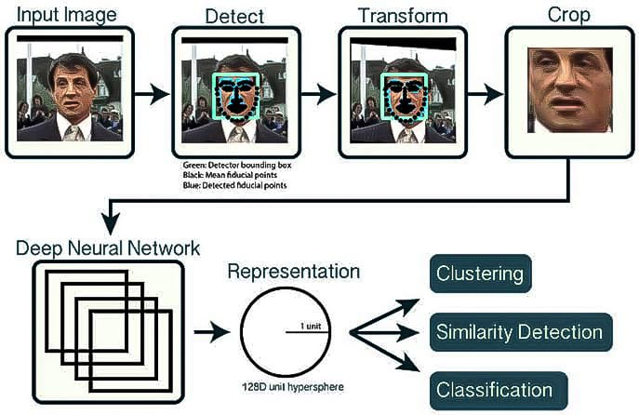
HOW DOES THE FACIAL RECOGNITION TECHNOLOGY WORK?
There are many ways in which this system work, but mainly, computer algorithms are used to pick out particular, distinguishing details about an individual’s face and then compare given image with faces present in the database. It consists of three major steps.
Detection of the face
Extracting Face Feature
Recognition of Face

Slide 8
Types Of Methods
Face recognition technology is improving day by day. Optics, computer vision, neural networks, pattern recognition, and many other research areas affect face recognition. Different types of methods for facial recognition are given in this section. They use different types of algorithms that support their purpose. The different types of methods are:
Geometric/Template Based
Piecemeal/Holistic Based
Appearance/Model Based
Template/Statistical/Neural Network Based

Slide 9
Applications of Facial Recognition Technology
Face recognition can help in finding missing individuals
Face recognition system can also be used to mark attendance in schools and colleges.
This is also helping various companies to secure their premises by controlling the access of the locations where only authorised people are allowed
Face unlocking feature of face recognition has already made our mobile phones secure.

Slide 10
Limitations of Facial Recognition Technology
Facial recognition software primarily depends on 2D images for the sake of convenience.
2D facial imaging won’t work in the dark as it depends on visible light spectrum
Image quality affects the working of face recognition technology.
Large storage capacity is required as the image samples stored of a person contain images with different angles which requires huge investments.

Slide 11
How to Overcome these Limitations?
These limitations are resolved by using IR cameras and thermal imaging and by installing high definition cameras and using more security cameras.
To deal with the storage issues Clusters of computers have to be set up with proper security and the ability to store huge amounts of data.
Some of these limitations will be solved as the technology improves. The mechanism will improve that will beat today’s algorithms, and obscuring parts of face with mask and sunglasses or changing hairstyles, expressions will not decrease the accuracy of facial recognition system.

Slide 12
Conclusion
Facial recognition is a very emerging field and will be more efficient with the advancement of technology.
This technology has drawn huge attention of law enforcement agencies and will soon help to create a safer world.
This technology holds a lot of potentials and would simplify the process and improve the flow of traffic significantly.

